Slide 1
How to Crack Office Word Password

Slide 2
Introduction to Authentication

Slide 3
Authentication Methods
Something you know
password, bank card PIN
Something you have
SecureID token
Something you are
finger and iris scans

Slide 4
How are passwords stored?
Username: john
Password: hello

Slide 5
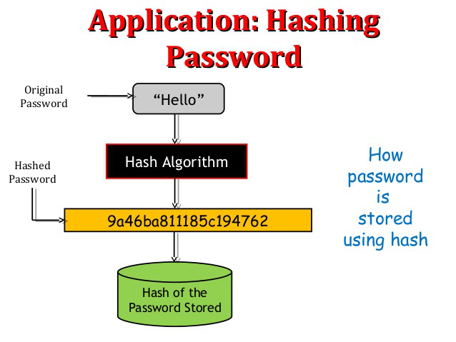
Password Hash

Slide 6
Required files for the lab

Slide 7
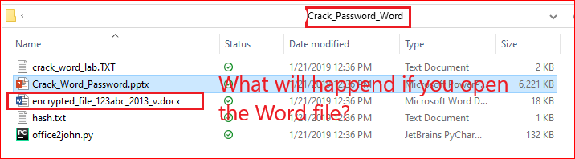
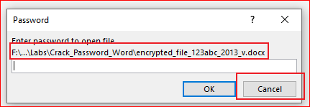
Verify the required files
Try to open the Word file

Slide 8
We are going to find the password!

Slide 9
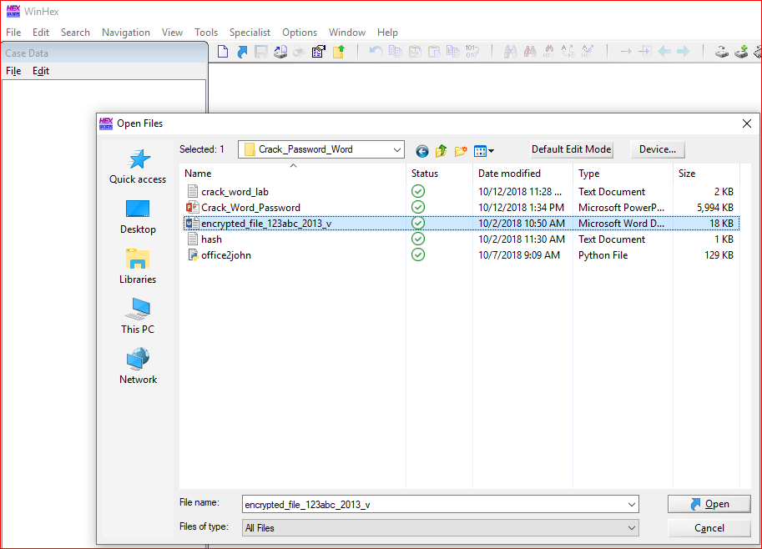

Slide 10
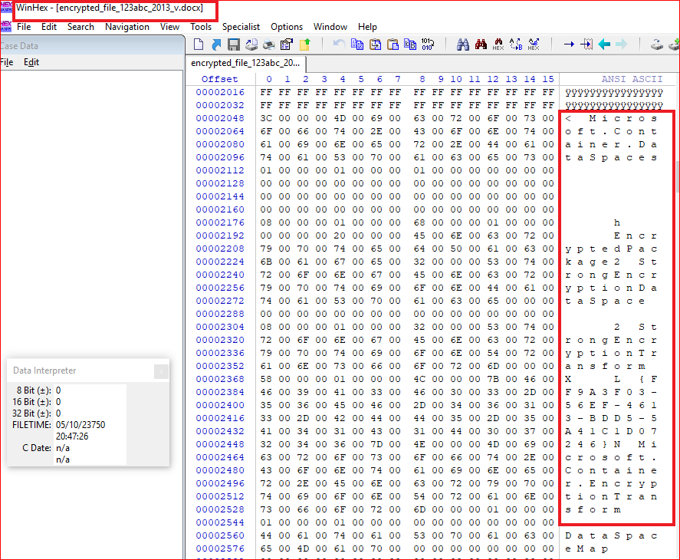

Slide 11
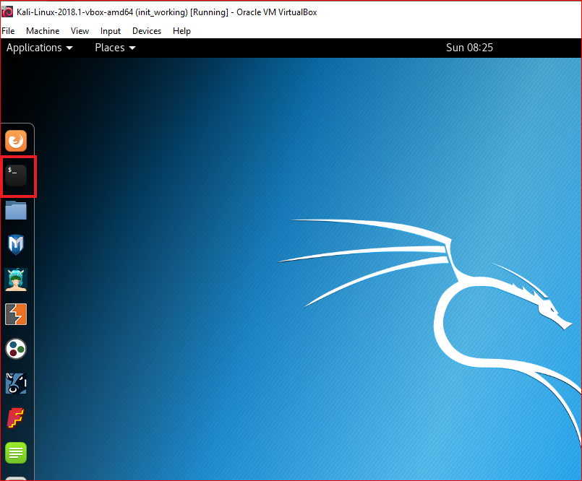
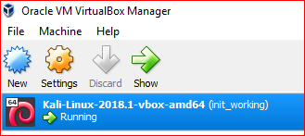

Slide 12
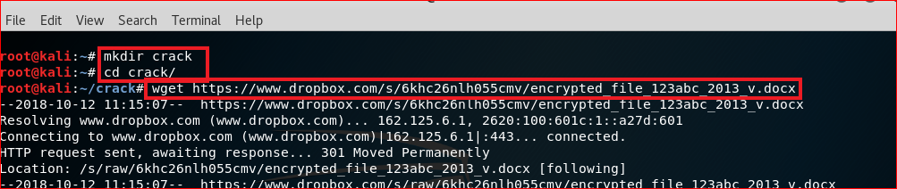
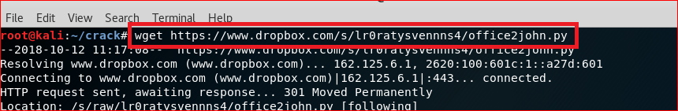
Download files
wget https://www.dropbox.com/s/6khc26nlh055cmv/encrypted_file_123abc_2013_v.docx
wget https://www.dropbox.com/s/lr0ratysvennns4/office2john.py

Slide 13
Extract Hash code of an encrypted Word file

Slide 14
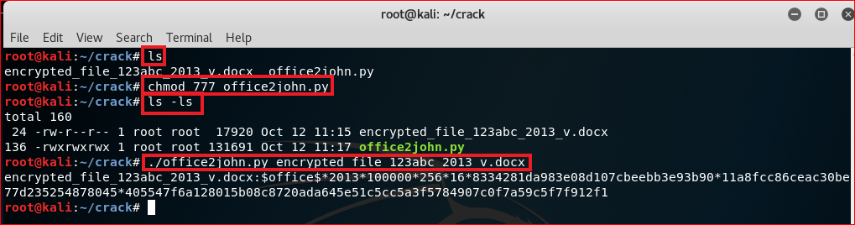
Use office2john to extract hash code from Word file’s header
encrypted_file_123abc_2013_v.docx:$office$*2013*100000*256*16*8334281da983e08d107cbeebb3e93b90*11a8fcc86ceac30be77d235254878045*405547f6a128015b08c8720ada645e51c5cc5a3f5784907c0f7a59c5f7f912f1

Slide 15
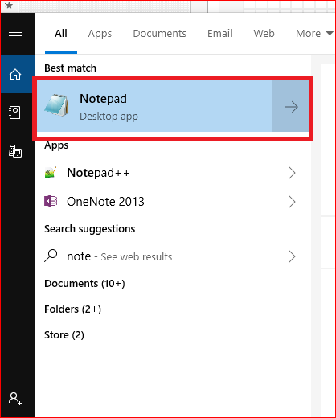
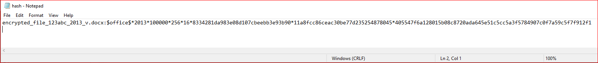
Copy the paste the hash code to hash.txt
encrypted_file_123abc_2013_v.docx:$office$*2013*100000*256*16*8334281da983e08d107cbeebb3e93b90*11a8fcc86ceac30be77d235254878045*405547f6a128015b08c8720ada645e51c5cc5a3f5784907c0f7a59c5f7f912f1

Slide 16
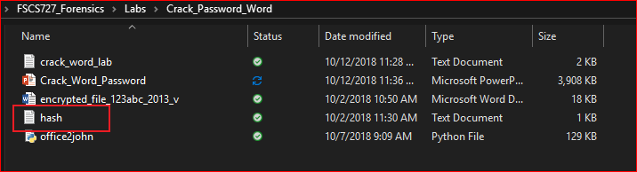
Verify

Slide 17
Use Hashcat in Kali

Slide 18
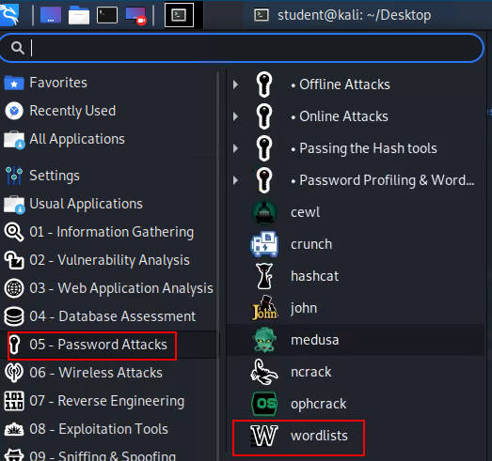
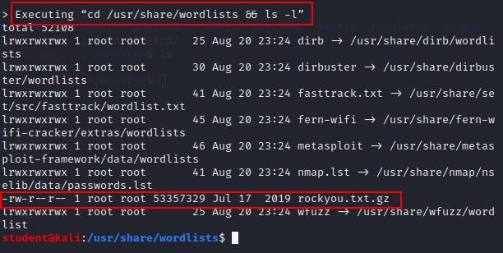
Unzip wordlist

Slide 19
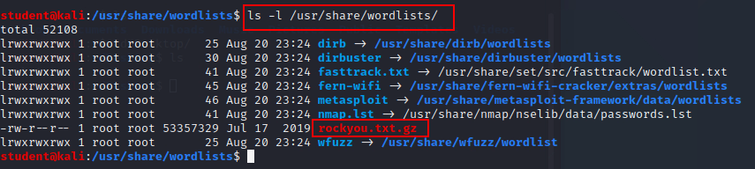
Find rockyou.txt.gz

Slide 20
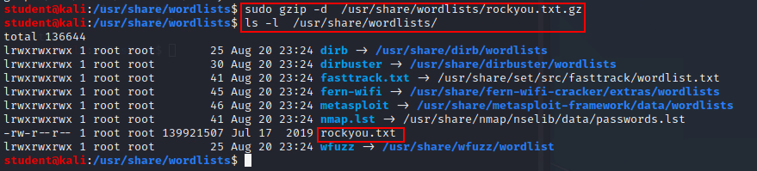
Unzip rockyou.txt

Slide 21
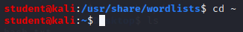
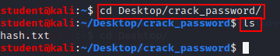
Go back to home directory

Slide 22
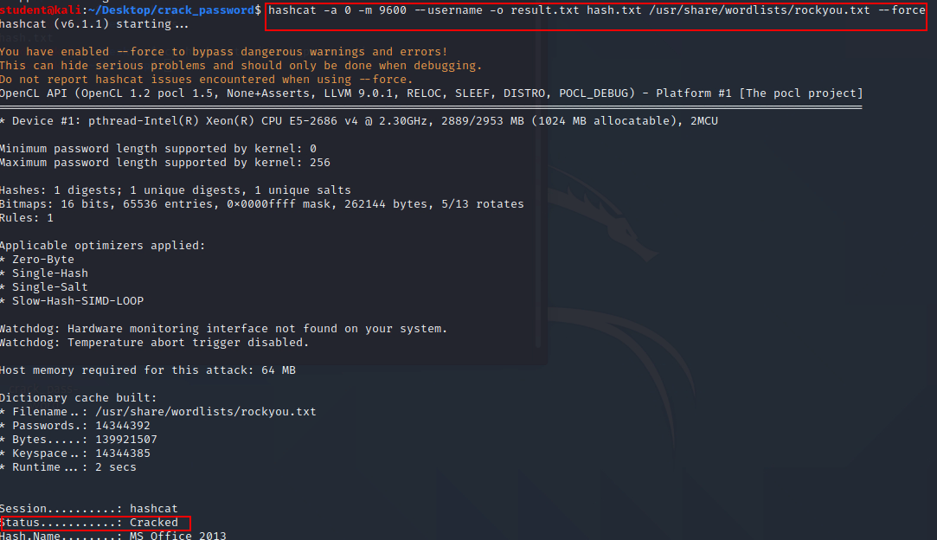
Cracking

Slide 23
Cracked!

Slide 24
Install crack software in Windows

Slide 25
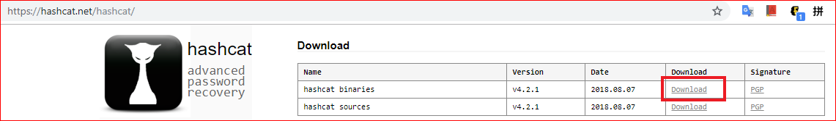
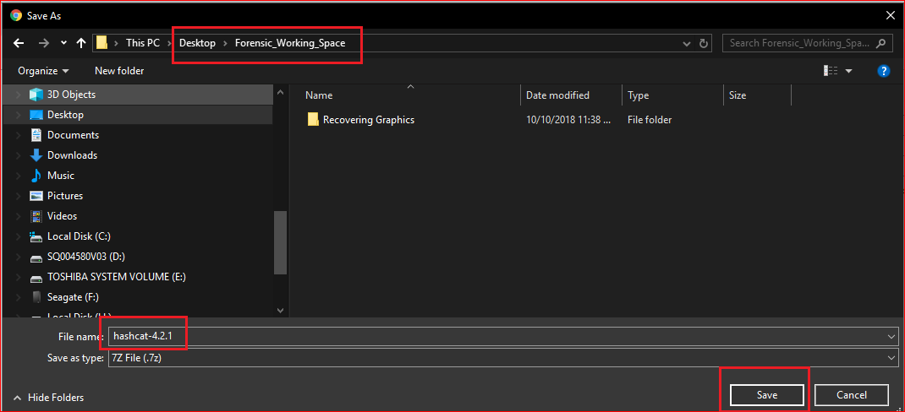
https://hashcat.net/hashcat/

Slide 26
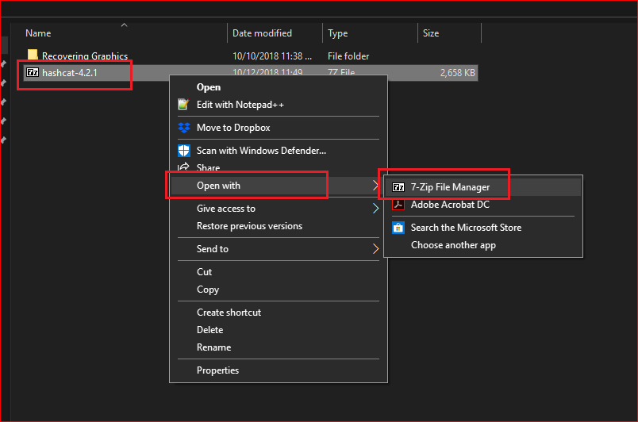

Slide 27
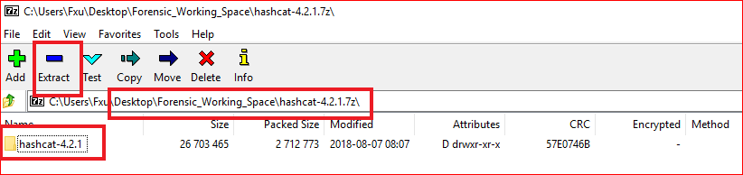
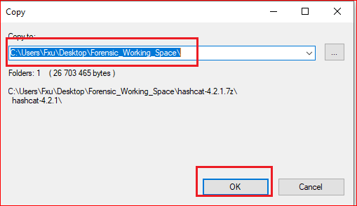

Slide 28
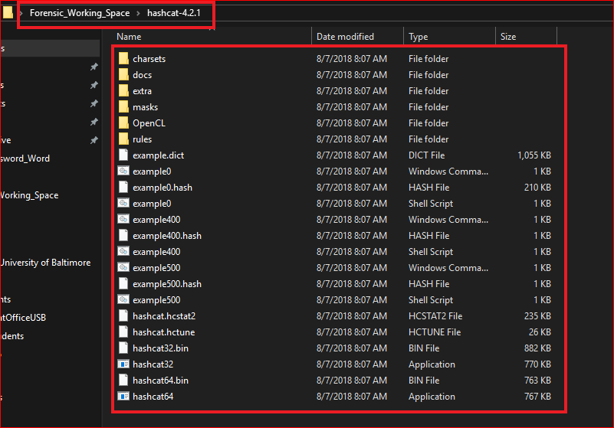

Slide 29
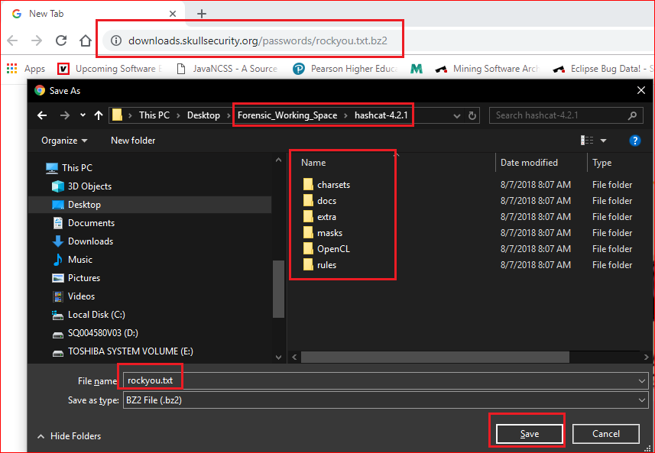

Slide 30
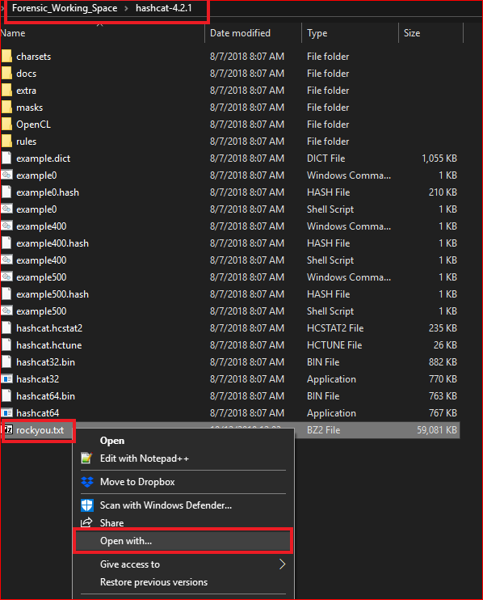
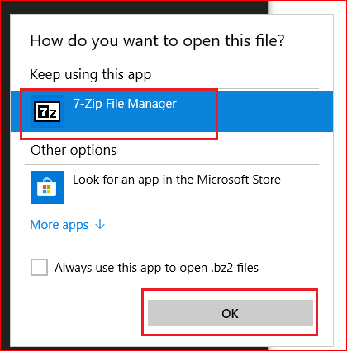

Slide 31
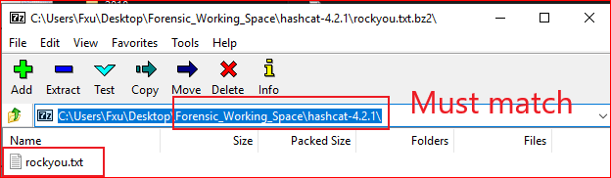
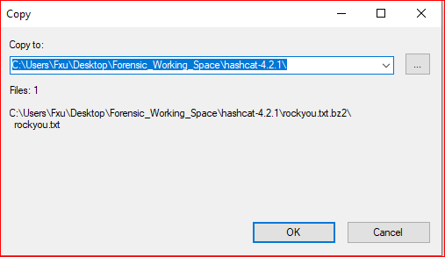

Slide 32
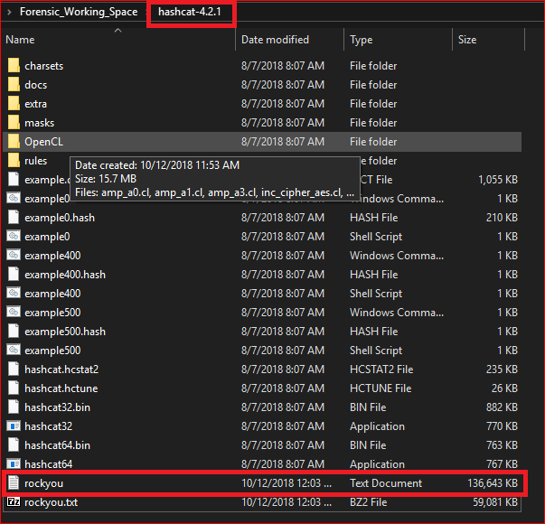
Verify

Slide 33
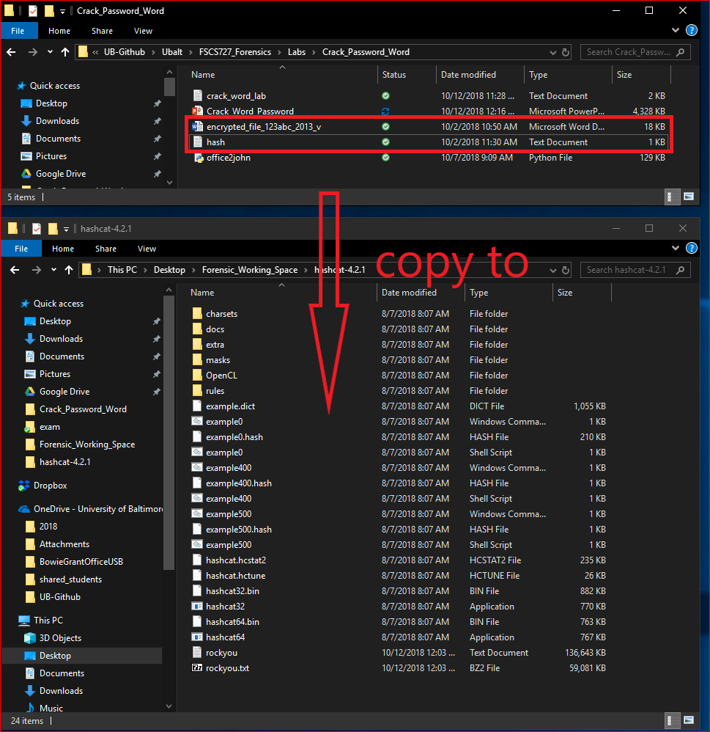

Slide 34
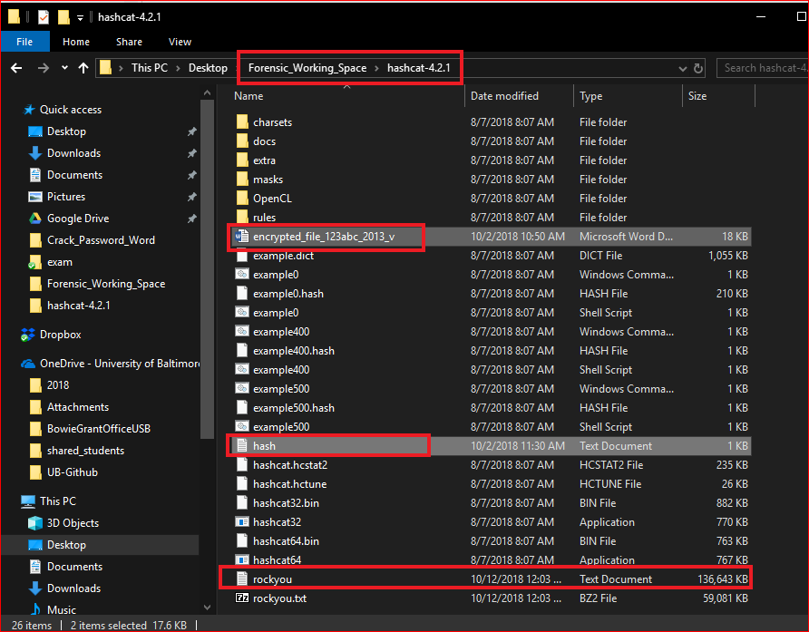

Slide 35
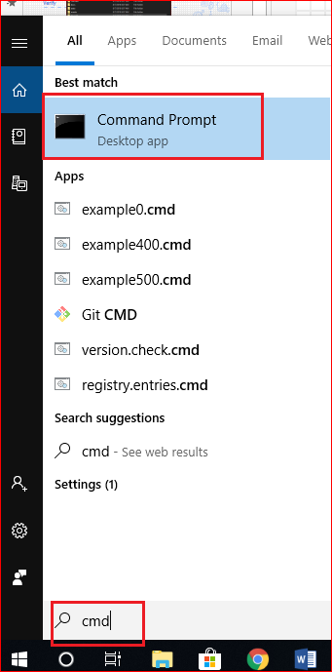
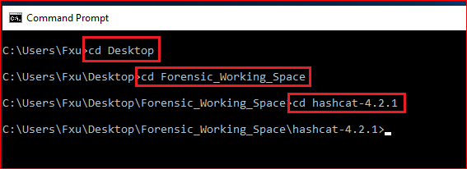

Slide 36
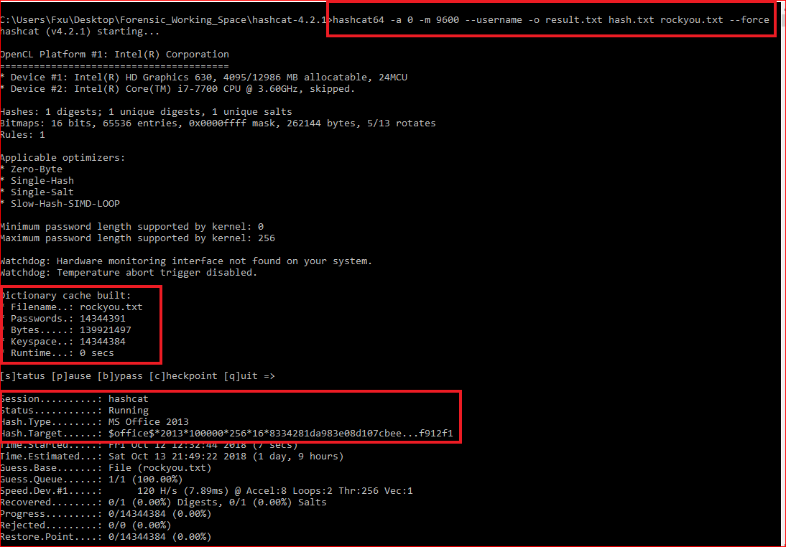
Last step

Slide 37
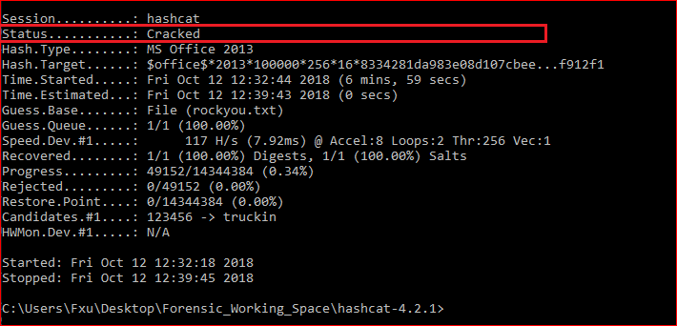

Slide 38
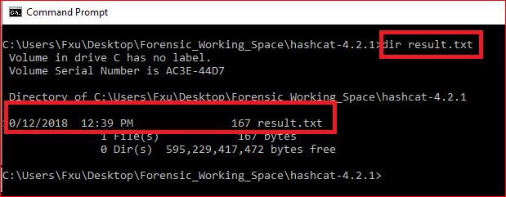
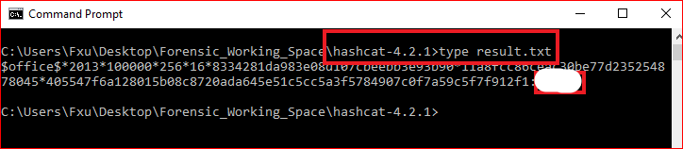

Slide 39
Reference
RC4 tutorial: https://www.youtube.com/watch?v=jjjq41bGzps
https://www.youtube.com/watch?v=lohwg1X0VH8
https://github.com/magnumripper/JohnTheRipper/blob/bleeding-jumbo/run/office2john.py
http://pentestcorner.com/cracking-microsoft-office-97-03-2007-2010-2013-password-hashes-with-hashcat/

Slide 40
Extra credits
https://www.dropbox.com/s/40ak15mk5xr8hvk/how_to_crack_pwd_123.pdf

